Slide 1

Welcome to Year 6

Slide 2
Meet the Year 6 Team:
Mrs Homewood & Mrs. Chidley – Juniper’s Class teachers
(Monday to Wednesday am - Mrs Homeward Thursday & Friday Mrs Chidley)
Mr Luka – Corben’s Class teacher
Mrs. Rose & Mrs. Vella – Year 6 TAs

Slide 3
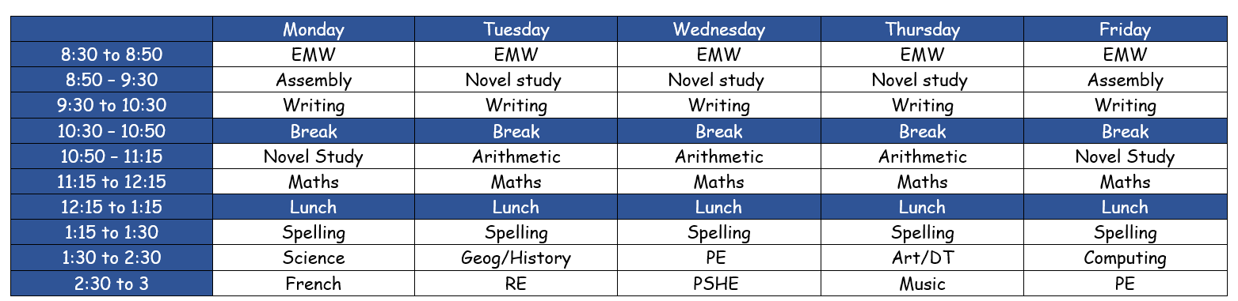
Our Timetable
(Timings not exact)

Slide 4
Attendance and Punctuality
8:25am GATES OPEN
8:30am CLASS DOORS OPEN
8:40am GATES CLOSED, REGISTER IS TAKEN. CHILDREN ARE EXPECTED TO BE IN THE CLASSROOM AND SETTLED BY THIS TIME. LEARNING IS SET UP FOR THEM TO COMPLETE FROM 8:30am.
3:10am ACORNS ARE DISMISSED
3:15pm OAKS ARE DISMISSED
If a child arrives to school after 8:40am, they must enter through the school office and they will be noted as LATE on the register.
If a child arrives after the register has been closed (8:50am), then this will be classed as an UNAUTHORISED ABSENCE (U code). 10 or more unauthorised absences within 10 school weeks may be subject to a Penalty Notice from KCC.

Slide 5

Our Term 1 Curriculum

Slide 6

Our Term 1 Curriculum

Slide 7
Home learning and how you can help at home
Times Table Rockstar – daily practice
Atom – weekly task.
Assigned on Friday and due on the following Friday.
Reading expectations:
Read at home everyday for 15-20 mins
Reading records signed and handed on a Friday.

Slide 8
Communication
School emails
Newsletters
Phone calls home
At the door in the morning.
We will always be available during the morning and after school on the door.
However, if you would like a longer discussion, after school is better than morning time due to taking the register.
You can make appointment through the office to see us: office@palacewood.kent.sch.uk

Slide 9
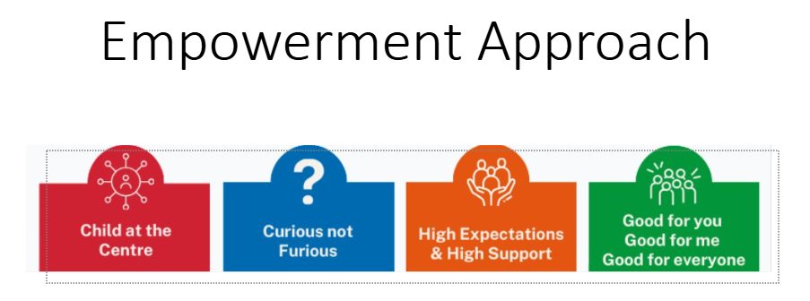

Slide 10
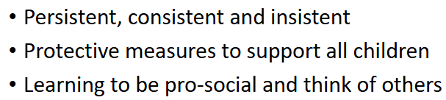
High expectations of behaviour

Slide 11


Slide 12


Slide 13


Slide 14
Thank you for listening
Any Questions?

