Slide 1



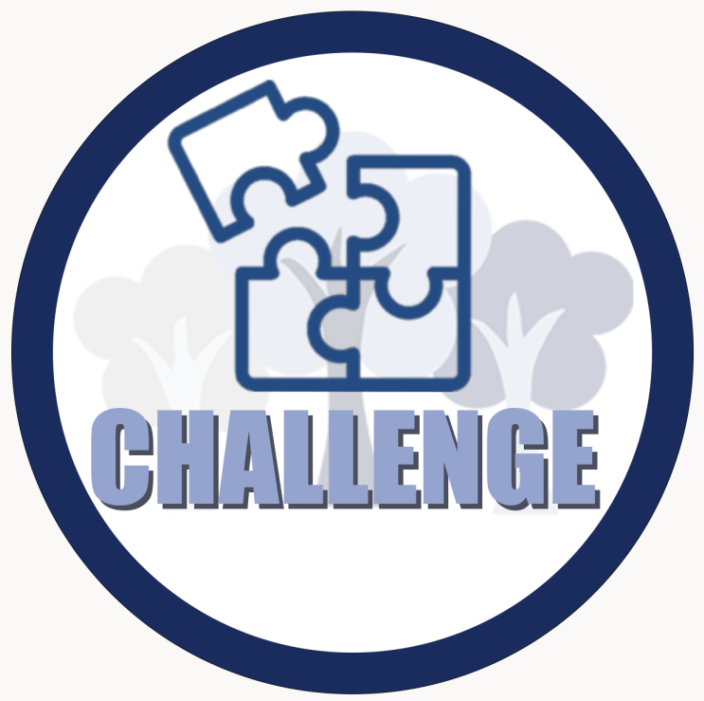


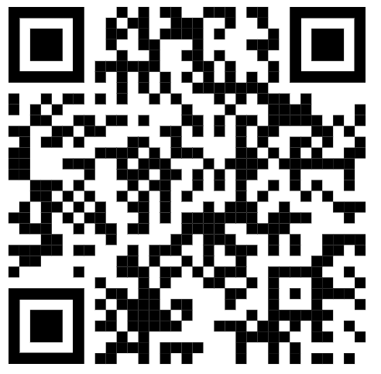
Year 1 – Term 1 – Book Warmer
We will be reading these books in class. Use this book warmer to help you explore the stories.
Our theme this term:
Imagine you could send a special message to everyone in your community.
What would you tell them?
Community
Can you design and create a model of a community where everyone belongs?
Create a "Perfect Community" using construction materials, drawing, junk modelling or LEGO.
How will you make your community welcoming?
If you could make ONE change to make our community better, what would it be?
Go on a community hunt with someone at home.
Can you find 5 things that help make your community special?
Vocabulary challenge:
Learn these words and draw a picture for each. Please bring your picture in for show and tell.
Community
Neighbour
Belong
Help
Together
Scan the QR code and watch the video to understand the meaning of a community.

